Slide 1
Atmospheric Pressure
The Cause of Wind

Slide 2
Pressure
Recall That…
Pressure is Force exerted per unit area
Measured in Pascals (Pa)
Usually expressed in millibars (mb)
Average at sea level 1013.2mb
Think of it as a column of air pressing down on your head…
Taller Column = Greater Pressure
Measurements taken by BAROMETER:
Either mercury or aneroid (p98-101)

Slide 3
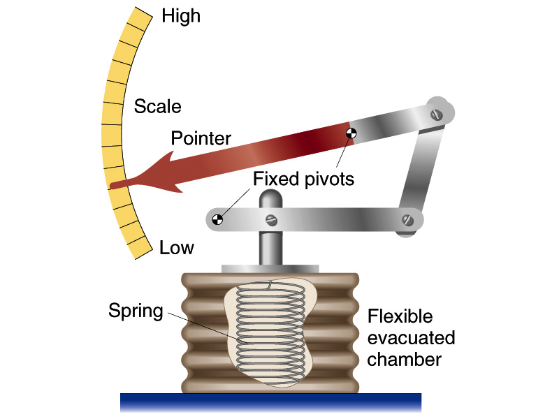
Aneroid Barometer

Slide 4
Wind
Wind is the result of horizontal differences in air pressure.
Air flows from areas of high pressure to areas of low pressure.
Pressure Gradient
Yet another natural ‘solution’ to ‘problem’ of imbalance of pressure.
Warm regions are less dense
Cold regions are more dense

Slide 5
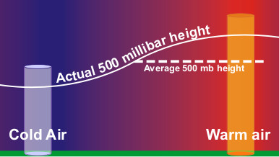

Slide 6
Pressure Gradient Force
This is the force that drives winds (causes air to move)
A ‘gradient’ usually refers to a change in some value over distance
Hill slopes, for example, have a change in elevation over a distance
so a gradient or slope can be calculated:

Slide 7
Pressure Gradient Force
Gradients:
Calculated as Rise/Run
25m
Gradient = Elevation/Distance
(25-15)/30 = 10/30 = 0.33
Elevation
15m
A
B
Distance (30m)

Slide 8
Pressure Gradient Force
A ‘Pressure Gradient’ is the same thing
But the ‘Rise’ value is pressure:
Calculates a change in Pressure over distance.
Here, wind blows from A to B
1024
P G F = Pressure/Distance
(1024-1012)/30 = 12/30 = 0.4
Pressure
1012
A
B
Distance (30m)

Slide 9
Pressure Gradient Force
Pressure Gradient Force, therefore, controls WIND DIRECTION
In fact, were there no other forces to consider, we would expect:
Air to move DIRECTLY from an area of High pressure to an area of Low pressure
This motion would be perpendicular to (ACROSS) the isobars…

Slide 10
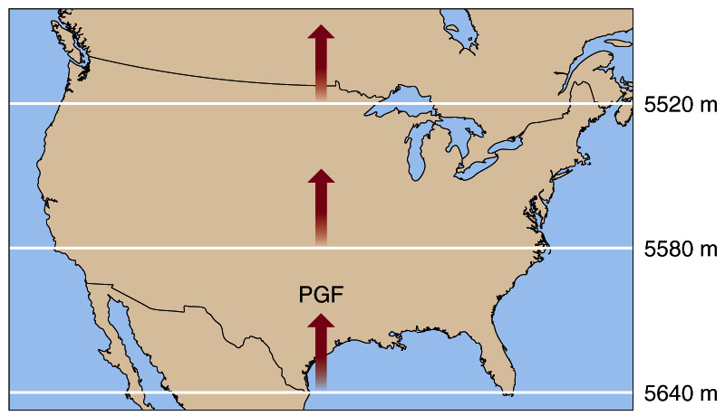
If PGF were the only force acting upon wind…

Slide 11
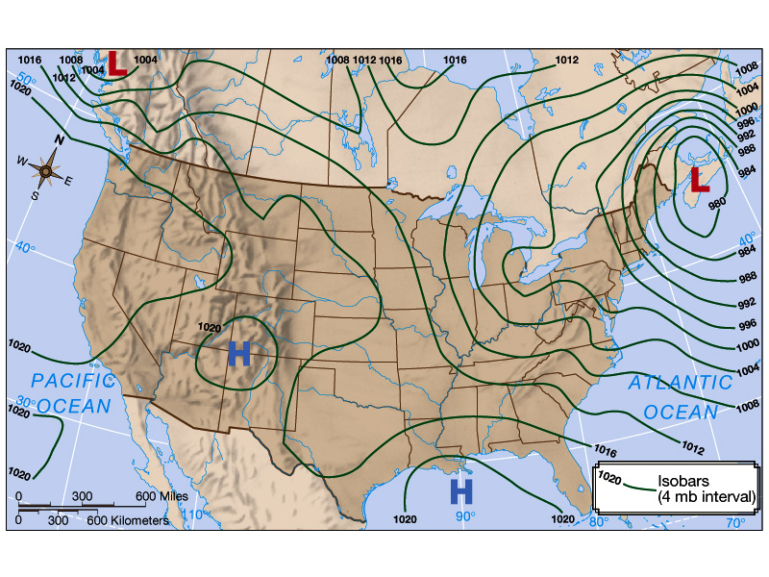
This Is What We Would Expect!!!

Slide 12
Pressure Gradient Force
Pressure Gradient Force, also controls WIND SPEED.
Pressure Gradient Force is steeper if there is a big change in pressure (Rise) over a short distance (Run).
Steep PGF = Faster Wind.
Isobars will be drawn close together in this scenario…

Slide 13
Pressure Gradient Force
1024
1024
1004
1004

Slide 14
Strong
Pressure Gradient
Weak
Pressure Gradient

Slide 15
Pressure Gradient Force
In Summary, PGF:
Causes winds to blow
Controls wind direction
Controls wind speed
ALL winds are affected by PGF

Slide 16
Wind
However
In addition to Pressure Gradient,
We have other forces that affect
The speed and/or
Direction of flow…
Coriolis Force
Friction

Slide 17
Coriolis Force
Causes an apparent deflection of objects to their own
RIGHT in the northern hemisphere
LEFT in the southern hemisphere
Caused by the rotation of the Earth’s Surface
It affects ALL freely moving objects…
So, ALL winds

Slide 18
Imagine Drawing A Straight Line Upon A Rotating Surface…
…Even Though The Path Of The Pencil Is Straight, The Resultant Line Is A Curve

Slide 19
Example…

Slide 20
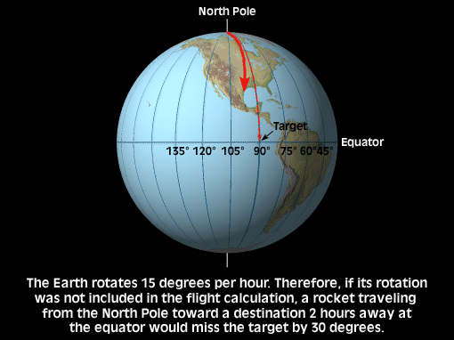
Example…

Slide 21
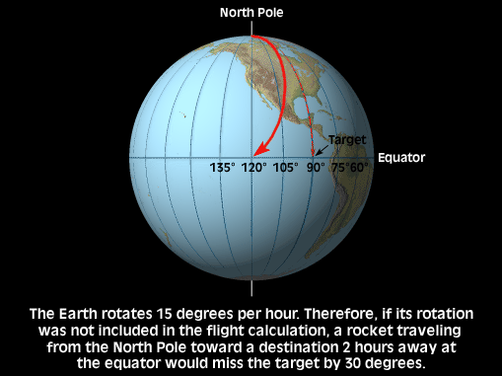
Example…

Slide 22
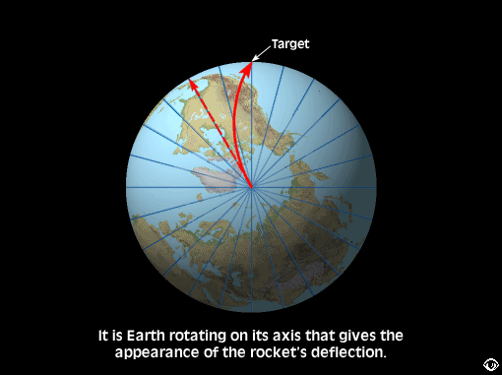
Example…

Slide 23
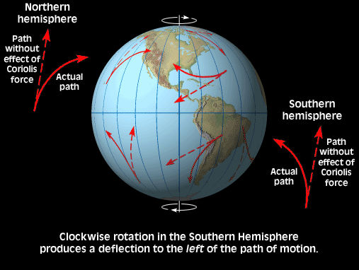

Slide 24
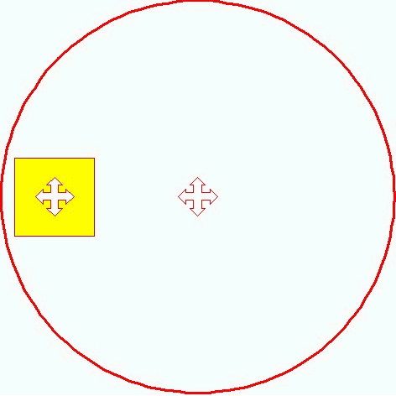
Regardless of your position upon a rotating surface (such as the earth)…
…It is ALWAYS the center of its own rotation!

Slide 25
http://www.baesi.org/TRG/coriolis/CORIOLIS.MOV

Slide 26
Coriolis Force
The Coriolis Force
Is greater at higher latitudes than at lower latitudes
Is stronger when flow is faster
In the case of wind, the greater the wind speed, the greater the deflection
Affects only the direction of flow, NOT the speed of flow
Only matters over LONG distances

Slide 27
Gradient Winds
Gradient Winds
Because the Coriolis Force deflects the path of winds, we find that
They do not flow perpendicular to isobars!
In fact, in the UPPER ATMOSPHERE, we find that winds blow parallel to isobars
This occurs as the Coriolis Force BALANCES the Pressure Gradient Force
Thus winds that follow the flow of isobars are called Gradient Winds
In special (rare) circumstances this flow is straight and is called Geostrophic

Slide 28
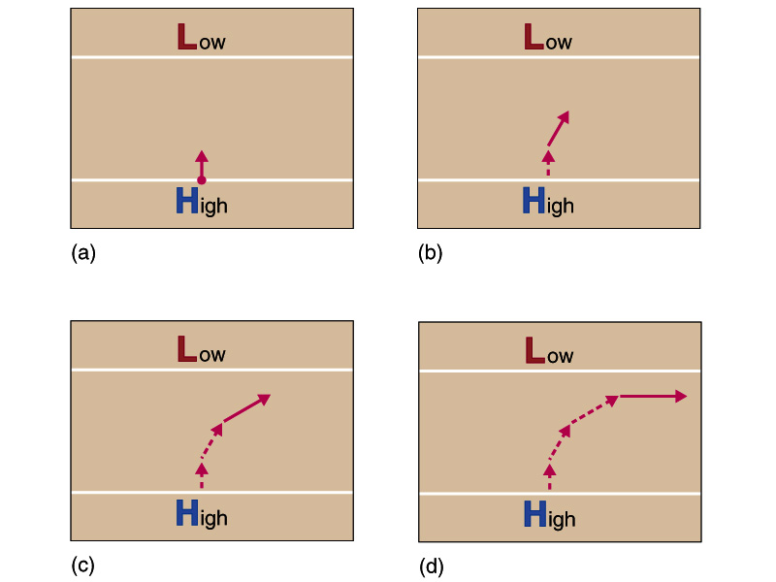
Gradient/Geostrophic Winds

Slide 29
http://www.baesi.org/TRG/coriolis/COREFFCT.MOV

Slide 30
Friction
Recall that:
The Coriolis Force is greater with Increased Flow (Air or Water)
When air flow occurs adjacent to a surface
Friction reduces the speed of that flow
Therefore, Friction weakens Coriolis Force in the LOWER ATMOSPHERE

Slide 31
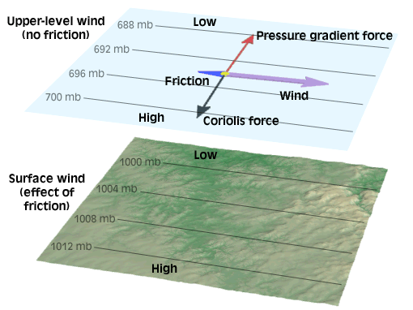

Slide 32
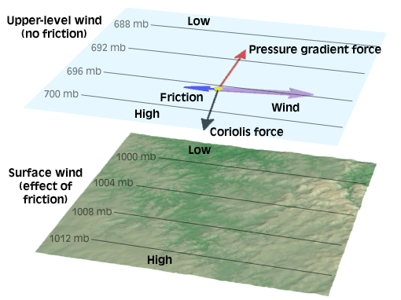

Slide 33
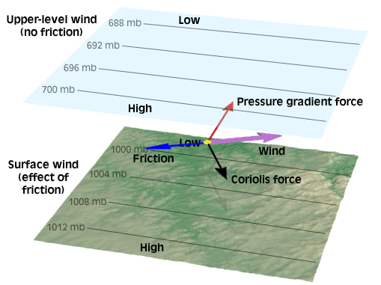

Slide 34
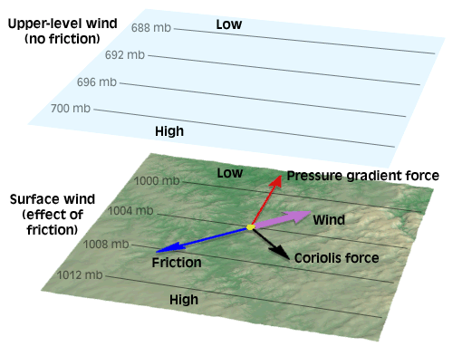

Slide 35
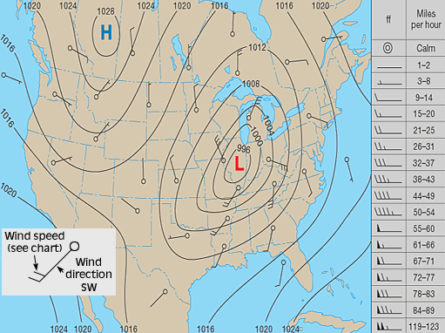
Lower Level Winds Cross Isobars At an Angle

Slide 36
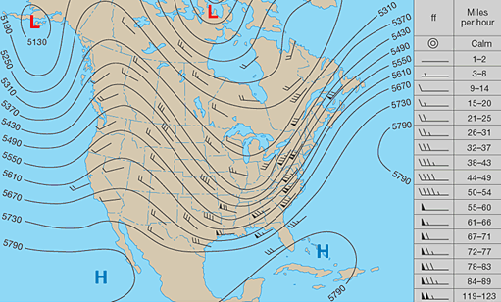
Upper Level Winds Are Parallel With Isobars

Slide 37
Cyclonic Flow
When a fluid (like air) rotates in the same direction as the Earth, it is said to be Cyclonic
Counter-clockwise in the Northern Hemisphere
Clockwise in the Southern Hemisphere
We associate Cyclonic Flow with areas of LOW pressure

Slide 38
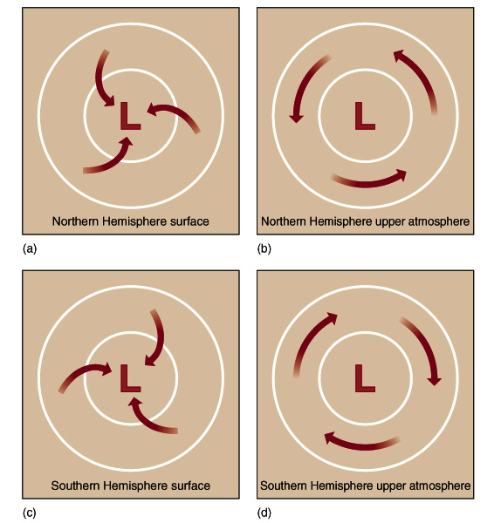
Deflected To The Right In Northern Hemisphere
Deflected To The Left In Southern Hemisphere

Slide 39
Anti-Cyclonic Flow
When a fluid (like air) rotates in the opposite direction as the Earth, it is said to be Anti-Cyclonic
Clockwise in the Northern Hemisphere
Counter-clockwise in the Southern Hemisphere
We associate Anti-Cyclonic Flow with areas of HIGH pressure

Slide 40
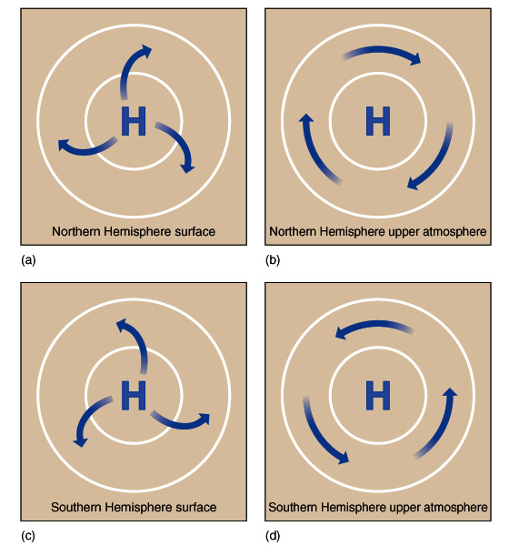
Deflected To The Right In Northern Hemisphere
Deflected To The Left In Southern Hemisphere

Slide 41
Low Pressure Systems
What causes a Low Pressure System?
Column of air is heated, which reduces density and increases it’s height
HIGH Pressure created aloft pushes air out of column reducing surface pressure
LOW Pressure is created at surface which sucks in surrounding air
So there is inward motion (Convergence)
This motion is affected by Coriolis Force & Friction

Slide 42
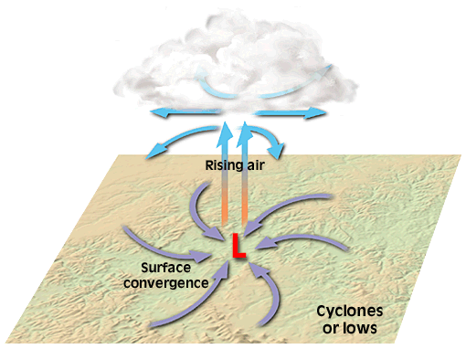
Because Low Pressure Systems force air aloft, they are associated with ‘Bad’ weather!

Slide 43
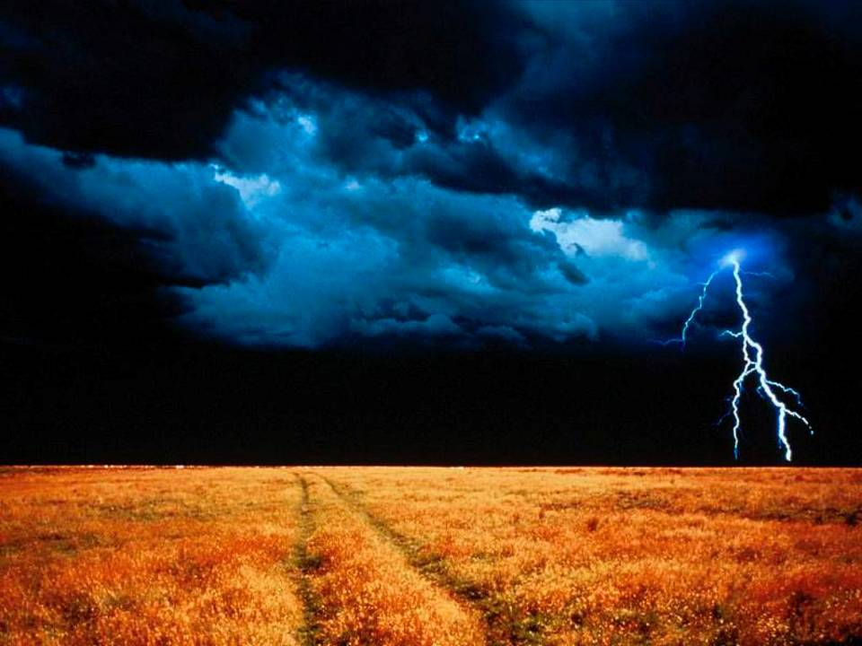

Slide 44
High Pressure Systems
What causes a High Pressure System?
Column of air is cooled, which increases density and decreases it’s height
LOW Pressure created aloft pulls air into column increasing surface pressure
HIGH Pressure is created at surface which pushes air out
So there is outward motion (Divergence)
This motion is affected by Coriolis Force & Friction

Slide 45
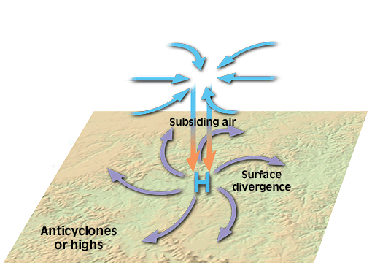
Because High Pressure Systems force air subsidence, they are associated with ‘Good’ weather!

Slide 46
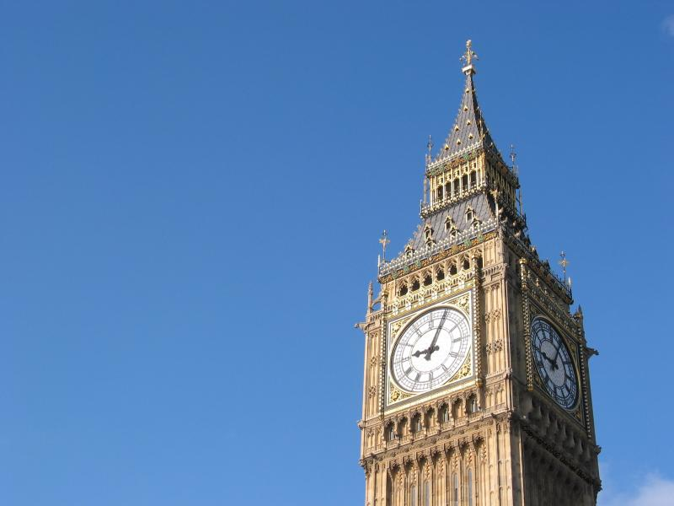

Slide 47
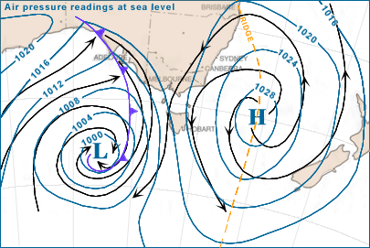
Southern Hemisphere…
Cyclone
Anti-Cyclone

Slide 48
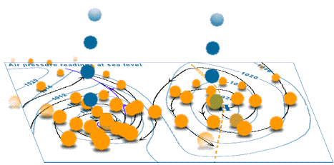
Southern Hemisphere…
Convergence: Deflected To The Left (Clockwise)
Divergence: Deflected To The Left (Counter-Clockwise)

Slide 49
Troughs & Ridges
Cyclones & Anti-Cyclones are ‘closed cells’
Isobars form localized concentric circles
However, Low & High pressure systems may be seen as elongated areas known as Troughs & Ridges
Troughs wrap around Low Pressures
Ridges wrap around High Pressures

Slide 50
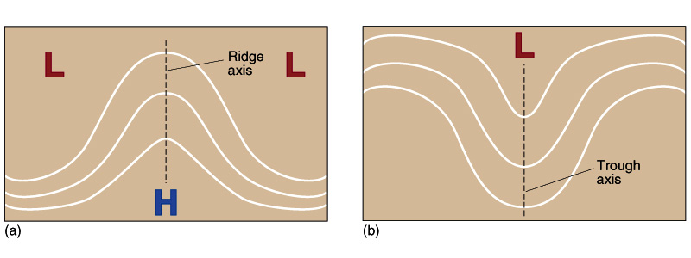
Ridges Have Clockwise Motion in the Northern Hemisphere
Troughs Have Counter-Clockwise Motion in the Northern Hemisphere

Slide 51
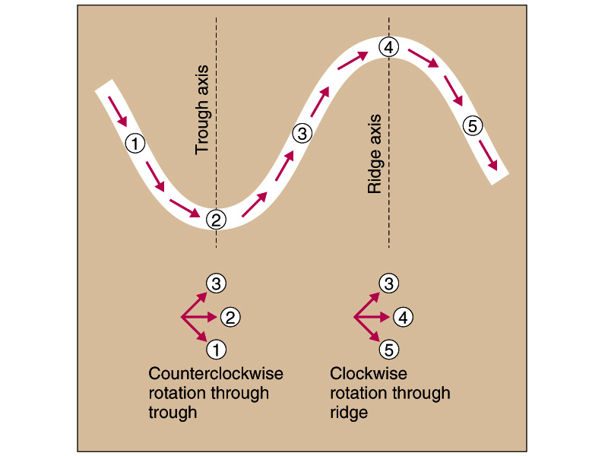

Slide 52
Super/Subgeostrophic Flow
Supergeostrophic
Clockwise flow around high pressure is FASTER than geostrophic straight line flow for same PGF
Coriolis > PGF so that flow can move in circle (NET force turning toward center)
Subgeostrophic
Counter-Clockwise flow around low pressure is SLOWER than geostrophic straight line flow for same PGF
Coriolis < PGF so that flow can move in circle (NET force turning toward center)

Slide 53
Troughs & Ridges
Flow around Ridge is clockwise so it is faster than Flow around Trough which is cyclonic
Convergence of air created between ridge and trough as it slows DOWN
This pushes air downwards, creating a near-surface High pressure
Divergence of air created between trough and ridge as it speeds UP
This pulls air upwards, creating a near-surface Low pressure

Slide 54
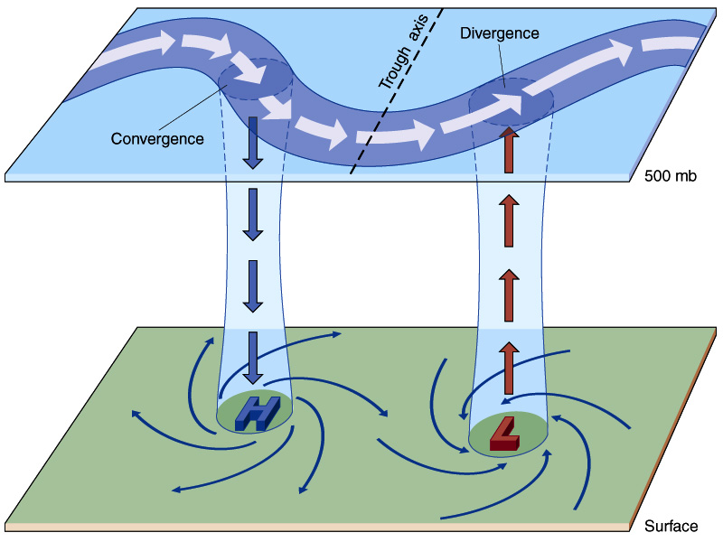

Slide 55
Troughs & Ridges
Typically:
Cyclones & Anti-Cyclones are more commonly found near the Earth’s Surface
Whereas Troughs & Ridges are more commonly found in the Upper Atmosphere

Slide 56
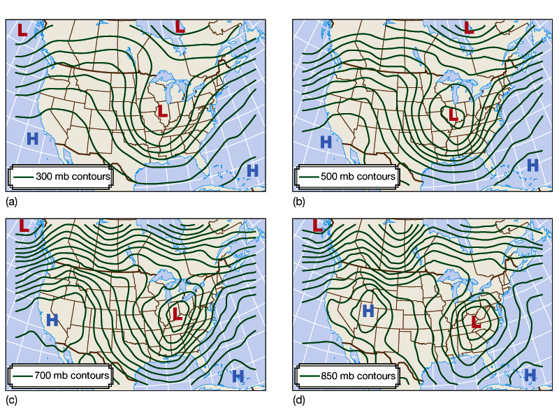
Upper Atmosphere
Lower Atmosphere

